Slide 1
CLUSTERING FUZZY C MEANS
DONE BY,
G.DHARANI[15EUIT024]
S.DIVYA BHARATHI[15EUIT028]
B.N.FAHEEN FATHIMA [15EUIT030]
S.HINDU SREENI[15EUIT040]

Slide 2
WEB LOG DATA ANALYSIS BY ENHANCED FUZZY C MEANS CLUSTERING
World Wide Web is a huge repository of information and there is a tremendous increase in the volume ofinformation daily. The number of users are also increasing day by day. To reduce users browsing time lotof research is taken place. Web Usage Mining is a type of web mining in which mining techniques areapplied in log data to extract the behaviour of users. Clustering plays an important role in a broad rangeof applications like Web analysis, CRM, marketing, medical diagnostics, computational biology, and manyothers. Clustering is the grouping of similar instances or objects. The key factor for clustering is some sortof measure that can determine whether two objects are similar or dissimilar. In this paper a novelclustering method to partition user sessions into accurate clusters is discussed. The accuracy and variousperformance measures of the proposed algorithm shows that the proposed method is a better method forweb log mining.

Slide 3
APPLICATION OF FUZZY C MEANS CLUSTERING FOR EMOTION CLASSIFICATION FROM SPEECH
In the present study, emotion recognition from speech signals was performed by using the fuzzy C-means algorithm. Spectral features obtained from speech signals were used as features. The spectral features used were Mel frequency cepstral coefficients and linear prediction coefficients. Certain statistical features were extracted from the spectral features obtained in the study. After the selection of the extracted features, cluster centers were identified by using type-1 fuzzy C-means (FCM) algorithm and used as input to the classifier. Supervised classifiers such as ANN, NB, kNN, and SVM were used for classification. In the study, all seven emotions of the EmoDB database were used. Of the features obtained, FCM clustering was applied to Mel coefficients and obtained clusters centers were used as input for classification. The results showed that using FCM for preprocessing aim increased the success rate. The comparison of the classification methods showed that the maximum success rate was obtained as 92.86% using the SVM classifier.

Slide 4
APPLICATION RESEARCH OF FUZZY C MEANS CLUSTERING ABOUT SOIL FERTILITY
Changes in Cultivated Land Fertility has important influence on food production, productivity. In this paper, by using acquired land evaluation data of Nong’an County Jilin Province, using entropy method to calculate the weight of all evaluation data, and to improve the weight to the original fuzzy C means clustering algorithm, C means clustering algorithm was gained based on fuzzy entropy weight finally. We applied this algorithm to evaluate soil fertility Nong’an County Jilin Province to get the results of its evaluation, the average accuracy rate of 94.02%, indicating the algorithm can be applied to the soil fertility evaluation.
Funds support: National 863 subjects (2006AA10A309); Jilin Agricultural University Scientific Research Foundation.

Slide 5
APPLICATIONS OF FUZZY C MEANS CLUSTERING IN VEHICULAR POLLUTION
Presently in most of the urban areas all over the world, due to the exponential increase in traffic, vehicular pollution has become one of the key contributors to air pollution. As uncertainty prevails in the process of designating the level of pollution of a particular region, a fuzzy method can be applied to see the membership values of that region to a number of predefined clusters. Also, due to the existence of different pollutants in vehicular pollution, the data used to represent it are in the form of numerical vectors. In our work, we shall apply the fuzzy c-means technique of Bezdek on a dataset representing vehicular pollution to obtain the membership values of pollution due to vehicular emission of a city to one or more of some predefined clusters. We shall try also to see the benefits of adopting a fuzzy approach over the traditional way of determining the level of pollution of the particular region.

Slide 6
BRAIN TUMOR DETECTION USING FUZZY C CLUSTERING
The medical image segmentation has become current research topic in the domain of data mining. Recently these are several numerous algorithm and variety of proposals done, in the segmentation process of brain tumors. In this paper, we propose a new algorithm, Fuzzy c-means that segments the brain tumor images. This research work mainly focused on Clustering method, specifically c-means & Fuzzy Clustering algorithm. This algorithm has been implemented and tested with MRI of Human Brain. It can get advantages of the Fuzzy c-means in the aspects of classification accuracy.

Slide 7
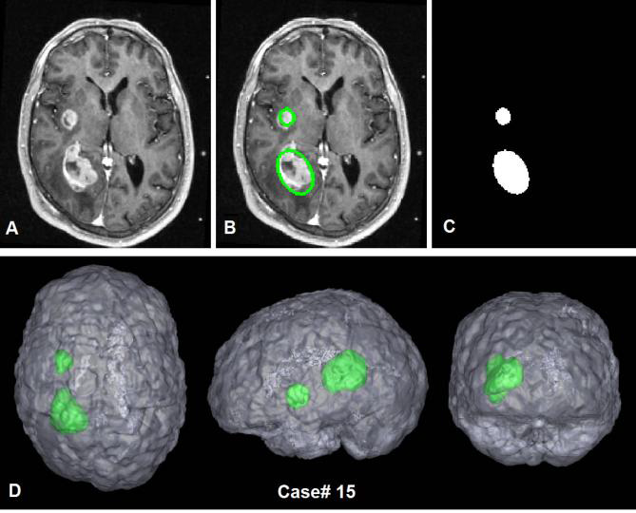
INPUT IMAGES
TABLE OF DETECTION RESULTS
IMAGE NAME IMAGE SIZE DETECTION
IN_0000N 255x255 Tumor Absent
IN_0002AB 255x255 Tumor Present
IN_0003AB 255x255 Tumor Present
IN_0007N 255x255 Tumor Absent
IN_0009AB 255x255 Tumor Present
IN_00011AB 255x255 Tumor Present

Slide 8
REFERENCES
https://link.springer.com/article/10.1007/s00521-016-2712-y
https://link.springer.com/chapter/10.1007/978-3-642-25781-0_30
http://ijsetr.org/wp-content/uploads/2016/03/IJSETR-VOL-5-ISSUE-3-688-693.pdf
http://ieeexplore.ieee.org/document/5966492/
https://www.researchgate.net/publication/250219902_Application_of_fuzzy_c-means_clustering_technique_in_vehicular_pollution

Slide 9
THANK YOU

